Slide 1
Red Hat OpenShift
July 21, 2017

Slide 2
Agenda
What is Red Hat Openshift?
ARCHITECTURE
LAB
Q&A

Slide 3
What is Red Hat OpenShift?
PaaS suite for managing cloud-deployed applications running in containers.
Wraps Docker and Kubernetes with an administration UI.
Supports both On-Premise and Cloud infrastructures.
Automates the provisioning, management, and scaling of applications across containers.

Slide 4
What is Red Hat OpenShift?
Includes templates for deploying and running Java, Node.js, .NET, Ruby, Python, and PHP applications.
Includes templates for creating database containers running relational and NoSQL databases such as MySQL, PostgreSQL, MongoDB, Redis, and SQL Lite.
Allows for the creation of persistent storage volumes.

Slide 5
What is Red Hat OpenShift?
Includes the necessary functionality to:
Pull application code from GitHub
Build the code
Deploy the code across all nodes in the system
Interface with build pipeline tools like Jenkins

Slide 6
What is Red Hat OpenShift?

Slide 7
Architecture
Architecture

Slide 8
ARCHITECTURE
https://www.slideshare.net/AmazonWebServices/containers-anywhere-with-openshift-by-red-hat
Slides 12 - 28
“Proudly Found Elsewhere (PFE)
makes for more rapid Innovation”
- https://blog.openshift.com/not-invented-here-is-not-an-option-for-openshift-origin/

Slide 9
ARCHITECTURE
https://blog.openshift.com/openshift-container-platform-reference-architecture-implementation-guides/

Slide 10
ARCHITECTURE
https://blog.openshift.com/openshift-container-platform-reference-architecture-implementation-guides/

Slide 11
ARCHITECTURE
https://blog.openshift.com/openshift-container-platform-reference-architecture-implementation-guides/

Slide 12
ARCHITECTURE
https://blog.openshift.com/openshift-container-platform-reference-architecture-implementation-guides/

Slide 13
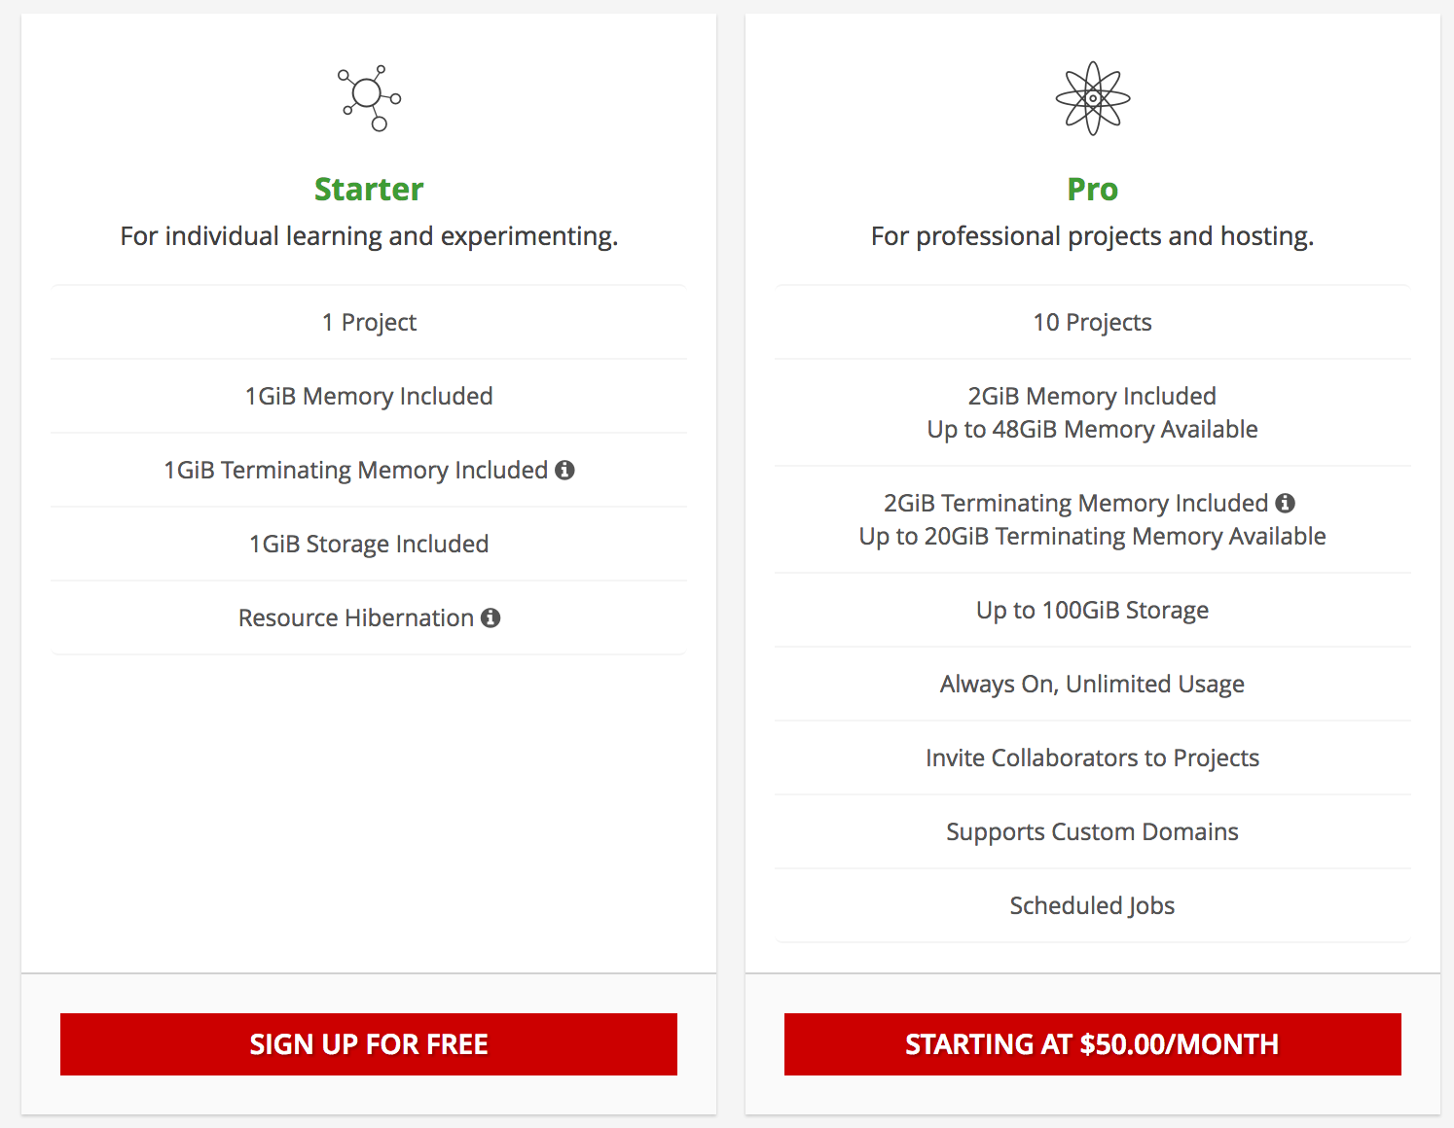
Openshift Resources
OpenShift Online
+ $0.035/hour per GiB

Slide 14
LAB
Lab

Slide 15
LAB
Requirements/Installation (Local)
Recent Mac OSX or Linux
Download and install Docker 1.13.x
https://download.docker.com/mac/stable/1.13.1.15353/Docker.dmg
A bug in OpenShift’s version of Kubernetes doesn’t work with the latest 1.17 version of Docker.
Run “docker version” to verify installation
Or sign up for a free (5 hour) free trial
https://redhat-google.orbitera.com/c2m/trials/signup
https://redhat-azure.orbitera.com/c2m/trials/signup

Slide 16
LAB (local)
Reset current Docker images/containers
Start over, clearing all existing Docker containers and Images.
Total Docker restart (for this exercise only)!
$docker stop $(docker ps -a -q)
$docker rm $(docker ps -a -q)
$docker rmi $(docker images)

Slide 17
LAB (LOCAL)
Requirements/Installation
Download and install the OpenShift command-line interface “oc”
https://access.redhat.com/downloads/content/290
Unpack (assuming in /Downloads)
Run shell commands to install “oc” to path:
$echo $PATH
$mv Downloads/oc /usr/local/bin
$oc version

Slide 18
LAB (LOCAL)
Download and Run OpenShift
Download and Launch OpenShift
$oc cluster up
Note OpenShift Docker images
$docker images
Note running OpenShift Docker containers
$docker ps

Slide 19
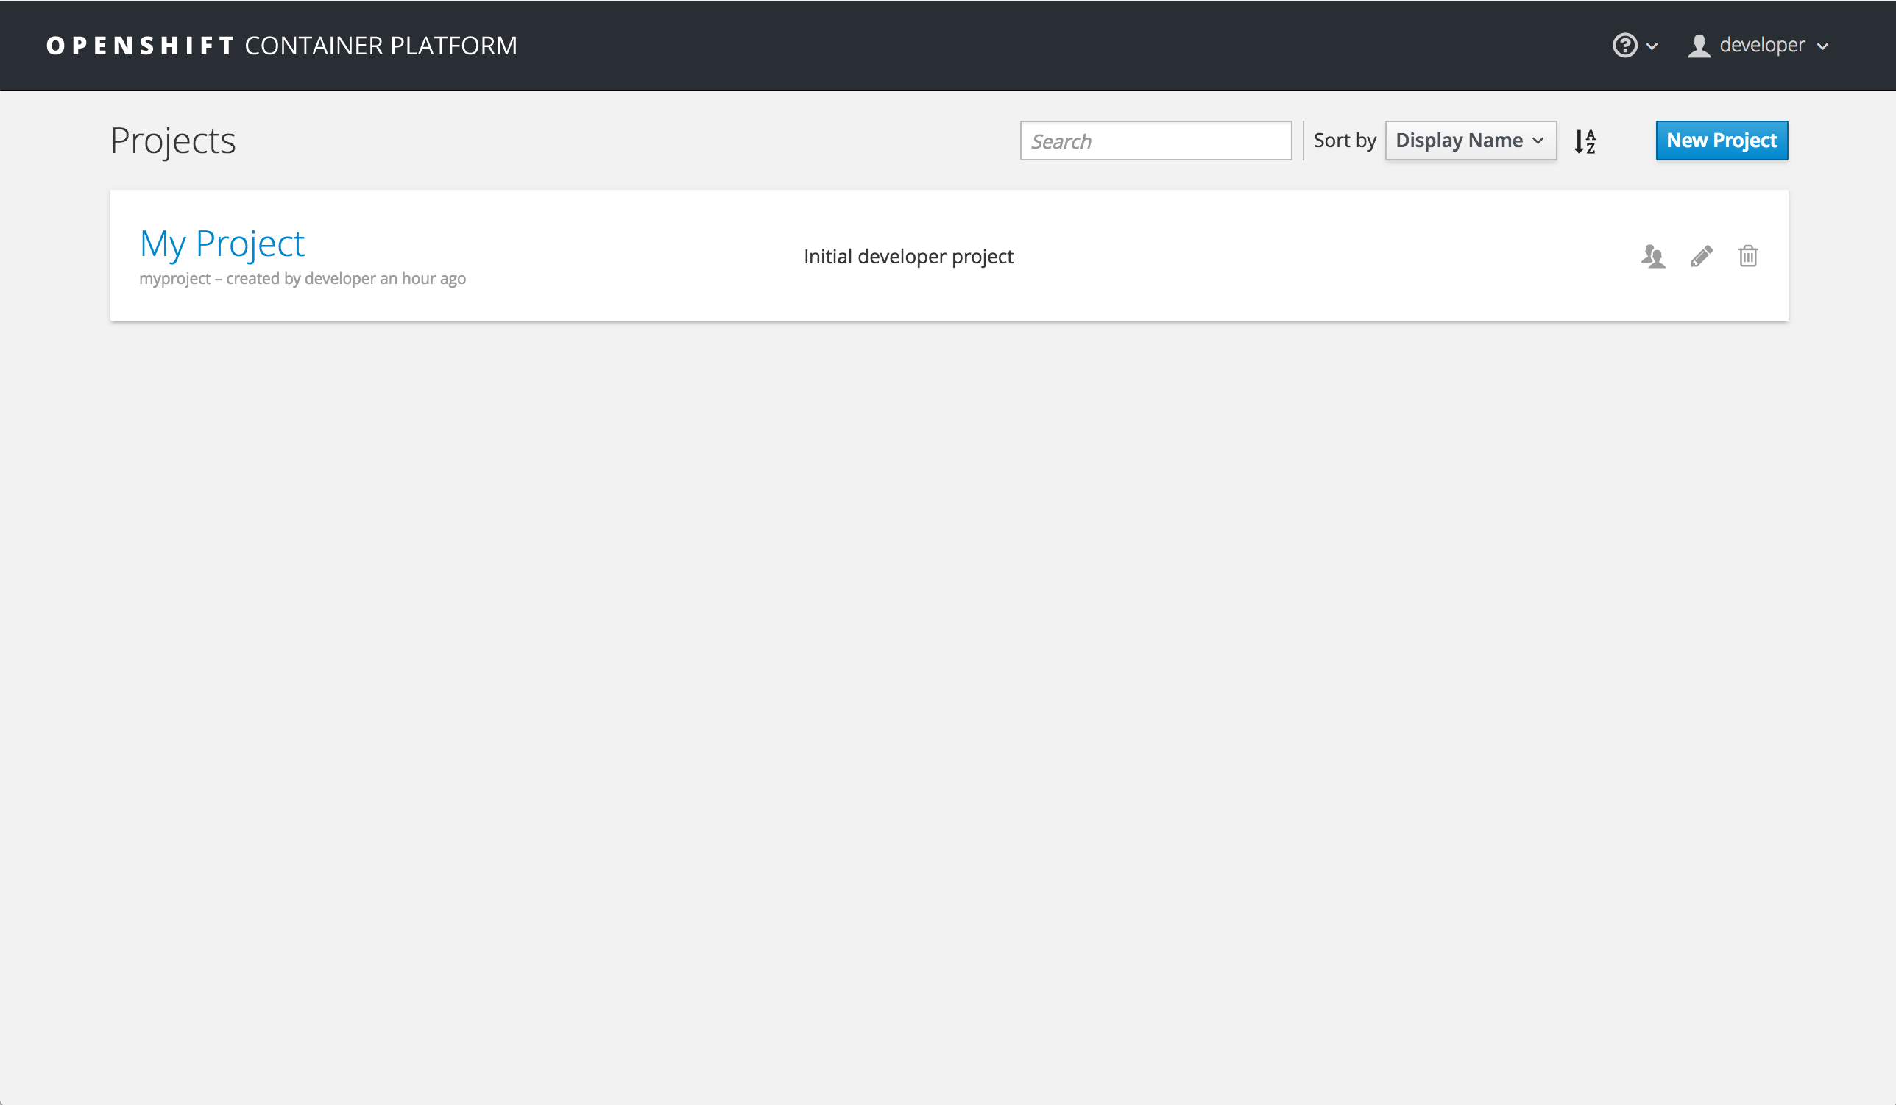
LAB (LOCAL)
Launch Admin console
Browse to:
https://127.0.0.1:8443
Log in with:
Username: developer
Password: developer

Slide 20
LAB
Create Test Project
Click My Project
Click Add to Project
Click the JavaScript language
Click Select on the Node.js + MongoDB (Persistent) template

Slide 21
LAB
Create Test Project
Change the Parameters:
Name: bootcamp-test
Memory Limit: 256Mi
Memory Limit (MongoDB): 256Mi
Volume Capacity: 128Mi
Git Repository URL:
https://github.com/TStuchel/nodejs-ex
Click Create

Slide 22
LAB
Review Project
Note two new deployment configs in Overview
bootcamp-test (the app)
mongodb (the database)
Note two new deployments in Applications->Deployments
bootcamp-test (the app)
mongodb (the database)
Note two new services Applications->Services
bootcamp-test (the app)
mongodb (the database)

Slide 23
LAB
Review Project
Note a new build under Builds->Builds
bootcamp-test (the app)
Note a new image under Builds ->Images
bootcamp-test (the app)
Note a new secret under Resources->Source Secrets
bootcamp-test (the app)
Note a new persistent volume claim Storage
mongodb (the database)

Slide 24
LAB
Update Application
Log into https://github.com/TStuchel/nodejs-ex
Change something within index.html
Navigate to Builds->Builds
Click bootcamp-test
Click Start Build, then View Log to watch
Navigate to Overview to watch deployment
Refresh application page to see changes.

Slide 25
Q&A

